Slide 1
CHAPTER 1
Natural Language Processing with Transformers
Hello Transformers
박세현
LAMDA Lab in SKKU

Slide 2
Transformer
In 2017, Google proposed a novel neural net-work architecture called Transformer
Architecture outperformed RNN on machine translation
high quality
less training cost
ULMFiT method
training LSTM networks on a very larg and diverse corpus

Slide 3
Transformer
Well-known models
GPT(Generative Pretrained Transformer)
BERT(Bidirectional Encoder Representations from Transformers)
Combining the Transformer with unsupervised learning
removed the need to train task-specific architectures
surpassing the existing performance of NLP

Slide 4
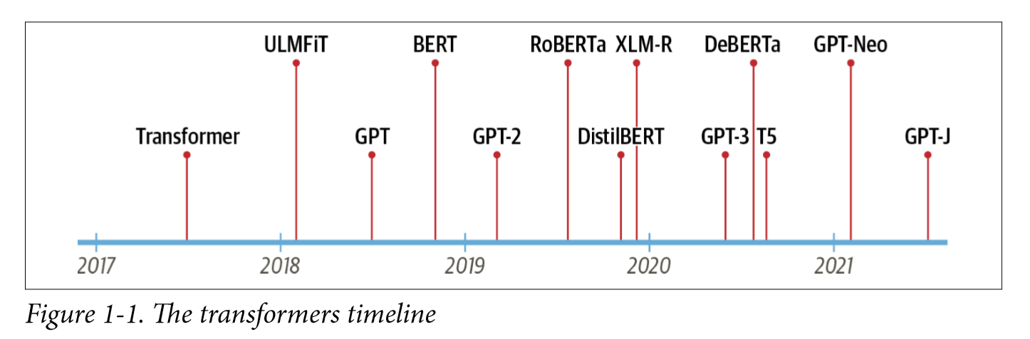
Transformer
Models after the release of GPT and BERT
About transformers
the encoder-decoder framework
attention mechanism
transfer learning

Slide 5
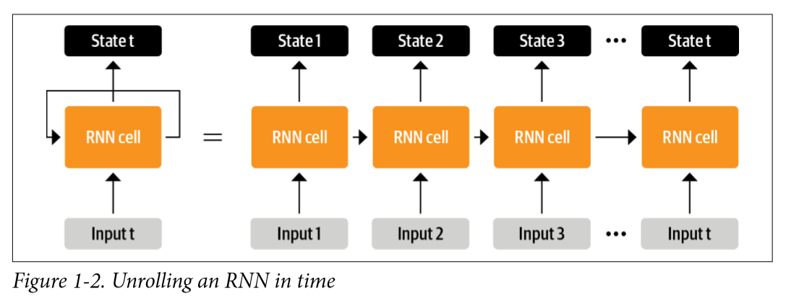
The Encoder-Decoder Framwork
Recurrent architectures
input data outputs a hidden state through the network
some informationback to itsef through the feedback loop
track of information form previous steps, and use it for its output predictions

Slide 6
The Encoder-Decoder Framwork
RNN
important role in development of machin translation
Machine Translation
encoder-decoder
sequence-to-sequence
suitable for situations where both input and output are sequences of arbitrary length

Slide 7
The Encoder-Decoder Framwork
Encoder
Encode information from the input sequence into the numbers in the last hidden state
Decoder
generates the output sequence
In general, the encoder and decoder components can be any kind of neural network architecture that can model sequences

Slide 8
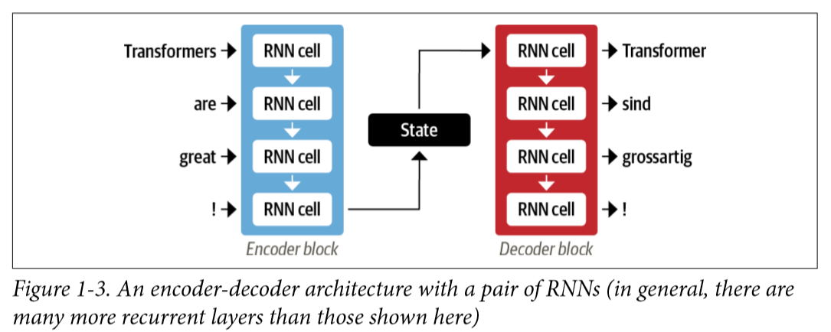
The Encoder-Decoder Framwork
input word - fed sequentially through the encoder
output word - generatied one at a time, from top to bottom

Slide 9
The Encoder-Decoder Framwork
Weakness
final hidden state of encoder creates an information bottleneck -> represent the meaning of the whole input sequence
long sequences might be lost in the process of compressing everything to a single
Key component called attention
acess to all of the encoder’s hidden states -> way out of this bottleneck

Slide 10
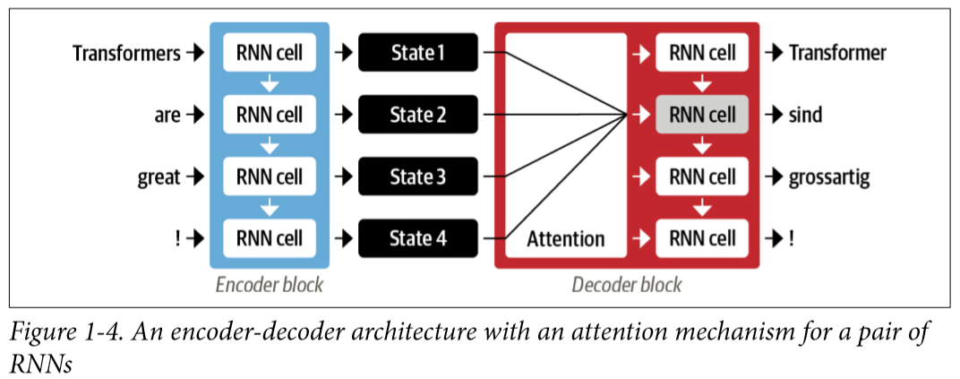
Attention Mechanisms
Attention
encoder outputs a hidden state at each step that the decorder can access
using all the states at same time would create a hug input for the decorder -> need to prioritize
decorder assign different amount of weight

Slide 11
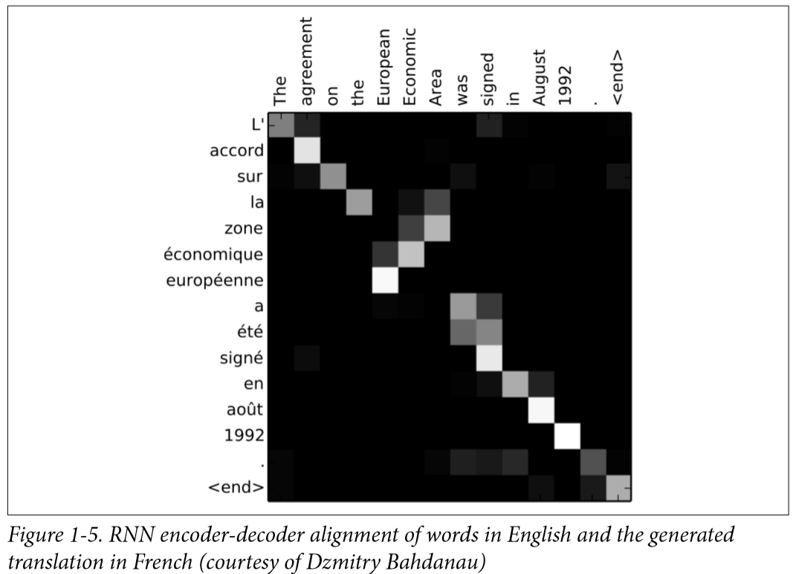
Attention Mechanisms
Attention-based-model
focus on relevant tokens at each timestep
able to learn nontrivial alignments between words in input a generated translation and a source sentence

Slide 12
Attention Mechanisms
Major shortcoming
computatinos are inherently sequential -> cannot be parallelized across the input sequence
※ New modeling paradigm - self-attention
dispense with recurrence altogether
Each output is fed into a feed-forward neural network (FF NN)
Learn much faster than a recurrent models

Slide 13
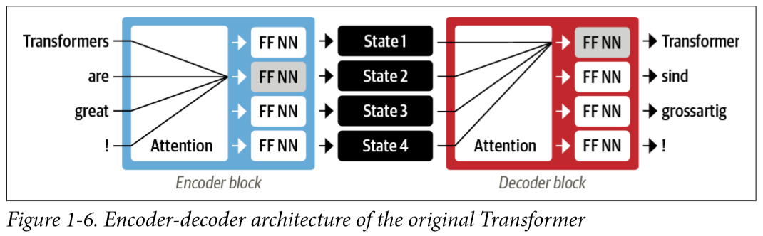
Attention Mechanisms
Allow attention to operate on all the states in the same layer
Both encoder and decoder have self-attention mechanisms
* Difficulty in obtaining sufficient lableled data in NLP -> need to transfer learning

Slide 14
Transfer Learning
Use of the knowledge learned from the original task -> fine-tune
Structure
head: task-specific network
body
weights of the body learn broad features of the source domain
weights are used to initialize a new model for the new task
More efficient for various downstream tasks with much less label data than conventional supervised learning

Slide 15
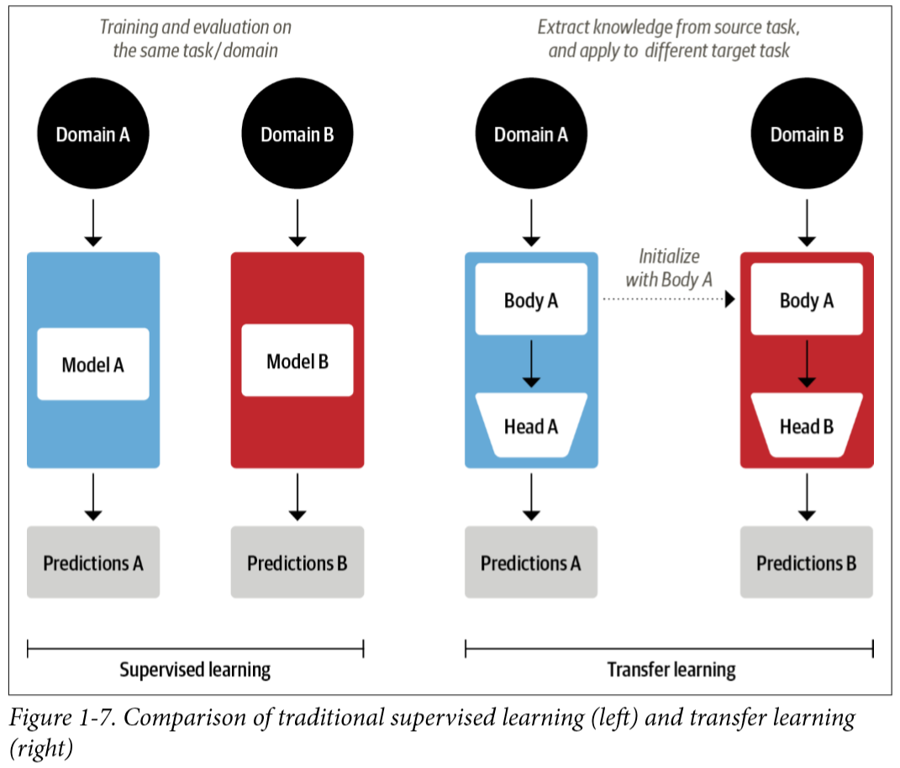

Slide 16
Transfer Learning
Pretrained model: first trained on large-scale datasets
Pretrained models can be fine-tuned in downsteam task with a relatively small number of labeled examples.
Fine-tuned model
achieve a higher accuracy than supervised models

Slide 17
Transfer Learning
In 2017 and 2018, new approachs were proposed that can apply transfer learning to NLP.
OpenAI researchers' sentiment classification task by using features extracted from unsupervised pretraining
ULMFiT
introduced a general framework to adapt pretrained LSTM models for various tasks

Slide 18
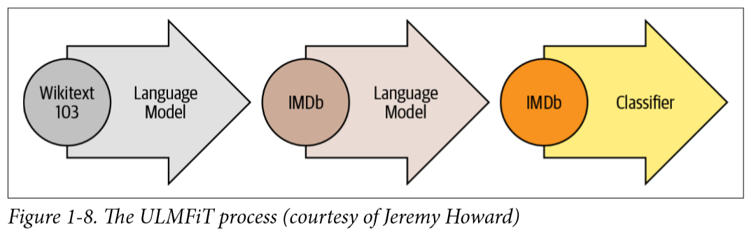
Transfer Learning
ULMFiT
Pretraining
Domain adaption
Fine-tuning

Slide 19
Transfer Learning
Pretraining
predict the next word based on the previous words called language modeling
Domain adaption
adapt to the in-domain corpus
use language modeling
predict the next word in the target corpus
Fine-tuning
fine-tuned with a classification layer for the target task

Slide 20
Transfer Learning
ULMFiT -> provided the missing piece to make transformers take off
In 2018, two transformers were released that combined self-attention with transfer learning
GPT
BERT

Slide 21
Transfer Learning
GPT
use only the decoder part of the Transformer architecture
the same language modeling approach as ULMFiT
pretrained on the BookCorpus
BERT
use the encoder part of the Transformer architecture
masked language modeling
predict randomly masked words in a text
pretrained on the BookCorpus and English Wikipedia

Slide 22
Transfer Learning
GPT and BERT set a new state of the art across a variety of NLP benchmarks and ushered in the age of transformers
different research labs releasing their models in incompatible frameworks
hard for NLP practitioners to port these models to their own applications
Release of Transformers
unified API across more than 50 architectures was progressively built
making it easy to integrate these models into many real-life applications

Slide 23
Hugging Face Transformers
Applying a novel machine learning architecture to a new task
1. Implement the model architecture in code, typically based on PyTorch or TensorFlow
2. Load the pretrained weights (if available) from a server
3. Preprocess the inputs, pass them through the model, and apply some taskspecific postprocessing
4. Implement dataloaders and define loss functions and optimizers to train the model.
-> requires custom logic
-> requires days of engineering to adapt to new use cases

Slide 24
Hugging Face Transformers
Transformer Library
Provide a standardized interface to transformer models.
Provide code and tools to apply to new cases
Support PyTorch, TensorFlow, JAX, allows easily switch between them
provides task-specific heads so you can easily fine-tune transformers on downstream tas

Slide 25
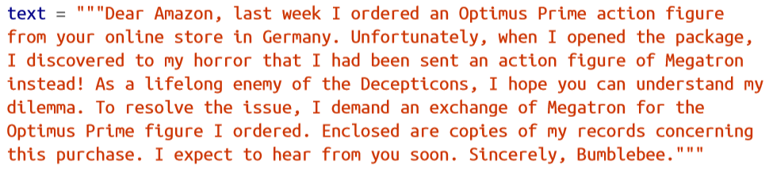

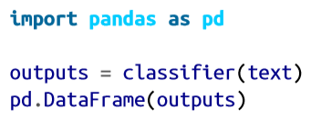
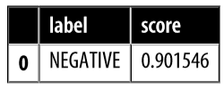
Tranformer Applications
Text Classification

Slide 26

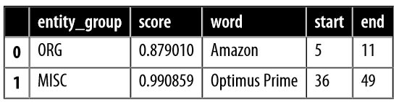
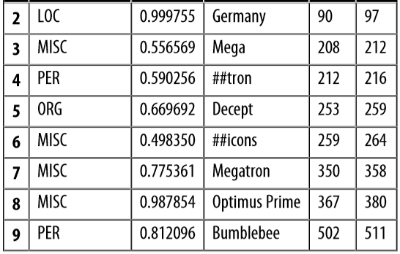
Tranformer Applications
Named Entity Recognition
＊ hash symbols (#) are produced by the model’s tokenizer

Slide 27
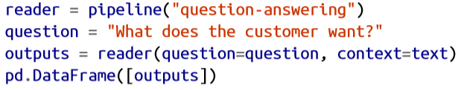
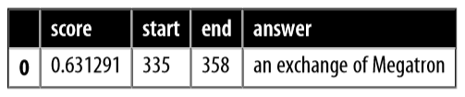
Tranformer Applications
Question Answering

Slide 28

Tranformer Applications
Summarization

Slide 29
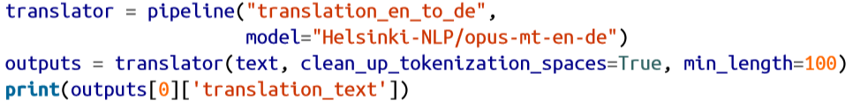
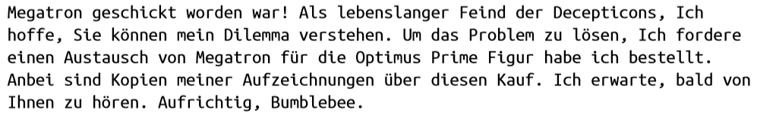
Tranformer Applications
Translation

Slide 30
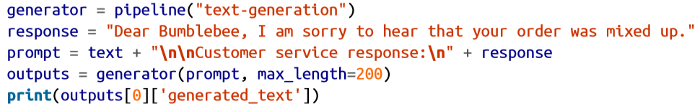
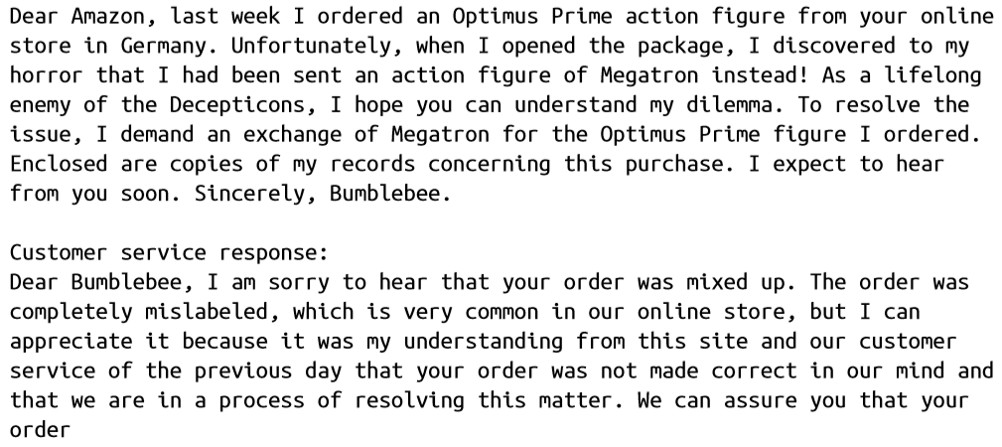
Tranformer Applications
Text Generation

Slide 31
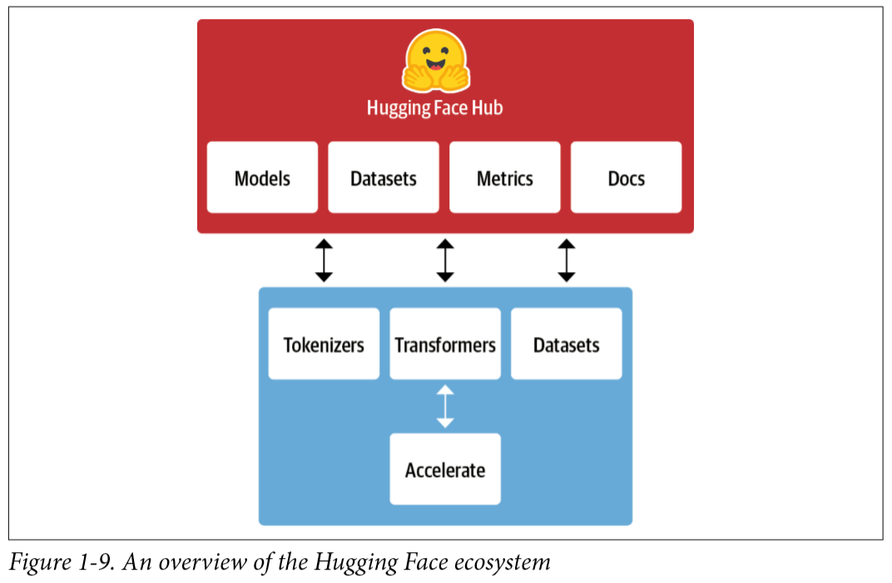
Hugging Face Ecosystem
Libraries
code
Hub
pretrained model weights
datasets
scripts for the evaluation

Slide 32
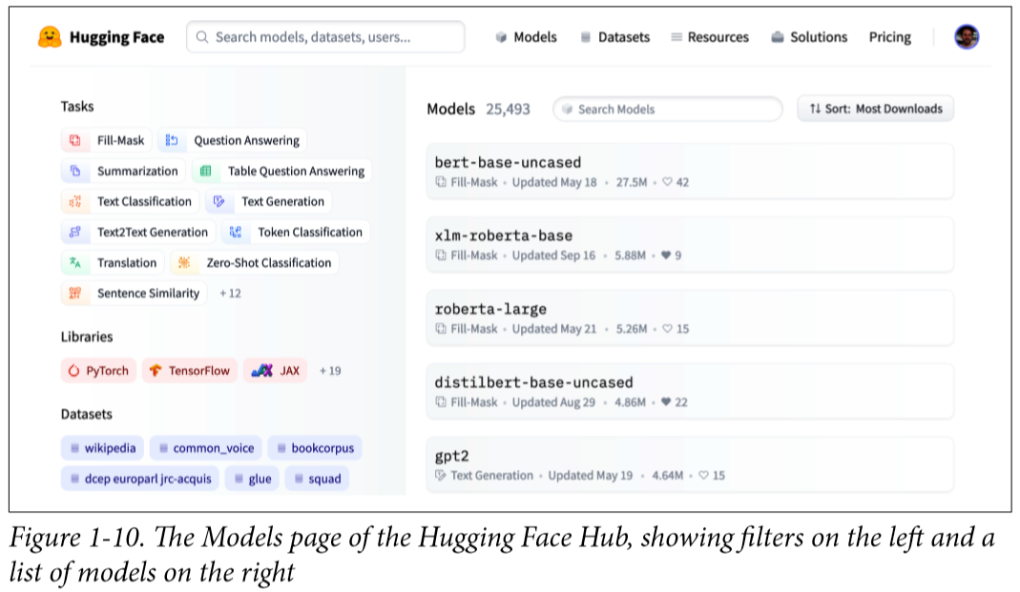
Hugging Face Hub
Hosts over 20,000 freely available models

Slide 33
Hugging Face Hub
Model wights
Datasets
Scripts for computing metrics -> reproduce published results, leverage additional data for your application
model and dataset cards - documentaion -> informed decision about whether they’re the right ones for you

Slide 34
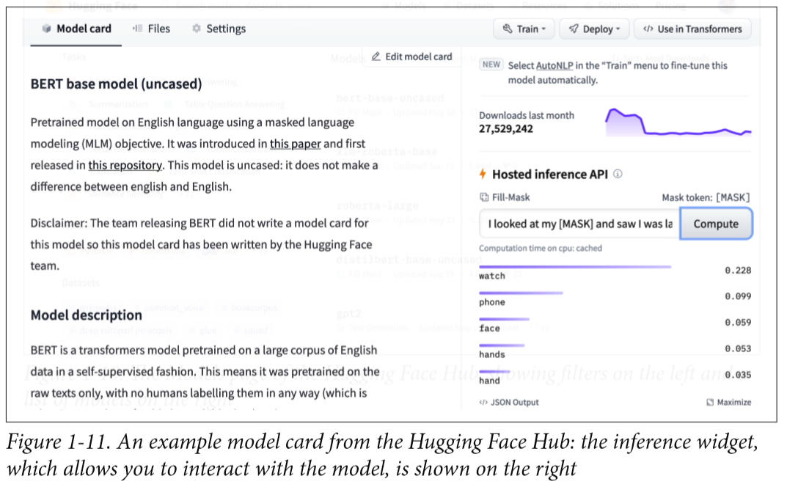
Hugging Face Hub
try out any model directly through the various task-specific interactive widget
* PyTorch and TensorFlow also offer hubs of their own and are worth checking out if a particular model or dataset is not available on the Hugging Face Hub.

Slide 35
Hugging Face Tokenizers
Tokenization : splits the raw text into smaller pieces called tokens
Tokenizers provides many tokenization strategies
Extremely fast at tokenizing text thanks to its Rust backend
takes care of all the pre- and postprocessing steps

Slide 36
Hugging Face Datasets
Standard interface for thousands of datasets that can be found on the Hub -> Simplifies this process
Smart caching
you don’t have to redo your preprocessing each time you run your code
Memory mapping
stores the contents of a file in virtual memory -> avoids RAM limitations by leveraging a special mechanism
Interoperable with popular frameworks like Pandas and NumPy

Slide 37
Hugging Face Accelerate
Normal training loops + layer of abstraction
Simplify the change of infrastructure
Accelerate workflow

Slide 38
Main Challenges with Transformers
Language
harder to find pretrained models for rare or lowresource languages
Data availability
still a lot compared to how much a human needs to perform the task
Working with long documents
paragraph-long texts becomes very expensive
Opacity
hard or impossible to unravel “why” a model made a certain prediction
Bias
imprints all the biases that are present in the data into the models

